Slide 1
LAB 1
Preeti Thareja

Slide 2
Problems to Solve
Cygwin Installation
Basic Linux commands

Slide 3
Basic Linux commands
File management
Directory Management
File permissions/Access modes
Process management

Slide 4
File Management
Commands | Description
touch filename | It will create and open a new blank file if the file with a filename does not exist. And in case the file already exists then the file will not be affected, except for its timing.
cat filename | This command will display the contents of the ‘filename’ file.
cp source/filename destination/ | It will create the new file in destination with the same name and content as that of the file ‘filename’.
mv source/filename destination/ | It will remove the file filename from the source folder and would be creating a file with the same name and content in the destination folder.
mv filename new_filename | It will rename the filename to new_filename or in other words, it will remove the filename file and would be creating a new file with the new_filename with the same content and name as that of the filename file.
rm filename | It will remove the filename file from the directory.

Slide 5
Directory Management
Cmd | Description
pwd | The pwd command stands for (print working directory). It displays the current working location or directory of the user. It displays the whole working path starting with /. It is a built-in command.
ls | The ls command is used to show the list of a folder. It will list out all the files in the directed folder. ls -l list a directory in detailed format including file sizes and permissions ls -a List the current directory including hidden files. Hidden files start with “.”
cd | The cd command stands for (change directory). It is used to change to the directory you want to work from the present directory. cd /usr/local Change current directory to /usr/local cd INIT change current directory to INIT which is a sub-directory of the current cd .. Change current directory to the parent directory of the current
mkdir | With mkdir command you can create your own directory.
rmdir | The rmdir command is used to remove a directory from your system. rm -rf [directory name]: this will delete all files and directories within the directory. Since rmdir will not delete the directory if it is not empty.

Slide 6
File Permissions
Permission Groups | File Permissions
user (u): these permissions will only apply to owners and will not affect other groups. Group (g): you can assign a group of users specific permissions, which will only impact users within the group. others (o): these permissions will apply to all users, and as a result, they present the greatest security risk and should be assigned with caution. | Read (r): Allows a user or group to view a file. Write (w): Permits the user to write or modify a file or directory. Execute (x): A user or grup with execute permissions can execute a file or view a directory.

Slide 7
File Permissions
Operators
`+` Add permissions
`-` Remove permissions
`=` Set the permissions to the specified values

Slide 8
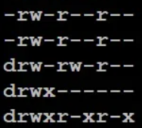
Ls -l
The first character
‘-‘, which means it’s a file
‘d’, which means it’s a directory.
The next nine characters = (rw-r–r–) show the security
Each of the three “rwx” characters refers to a different operation you can perform on the file.
--- --- ---
rwx rwx rwx
user group other

Slide 9
Changing security permissions
Chmod: Change mode
chmod o+x xyz.txt
give “execute” permission to the world (“other”) for file “xyz.txt”
chmod ugo-rwx xyz.txt
change multiple permissions at once, this will revokes all the read(r), write(w), and execute(x) permission from all user(u), group(g), and others(o) for the file xyz.txt

Slide 10
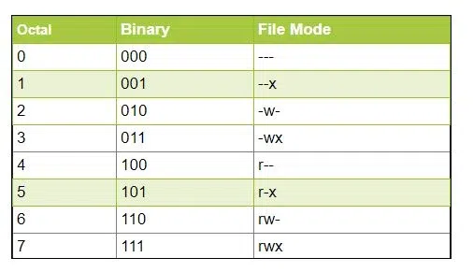
Octal Notations

Slide 11
Examples
chmod ugo+rwx [file_name]
chmod 777 [file_name]
Both of them provide full read write and execute permission (code=7) to all the group.
chmod u=r,g=wx,o=rx [file_name]
chmod 435 [file_name]
Both the codes give read (code=4) user permission, write and execute (code=3) for the group and read and execute (code=5) for others.
chmod 775 [file_name]
chmod ug+rwx,o=rx [file_name]
Both the commands give all permissions (code=7) to the user and group, read and execute (code=5) for others.

Slide 12
Process Mangement
ps command is short for ‘Process Status’. It displays the currently-running processes.
To stop a process in Linux, use the 'kill’ command.
Df free hard disk space on system.
Free give free RAM on your system.
Nice starts a process with a given priority.
Renice change priority of an already running process.
Notes:
Foreground Processes: They run on the screen and need input from the user. For example Office Programs
Background Processes: They run in the background and usually do not need user input. For example Antivirus.

